Slide 1
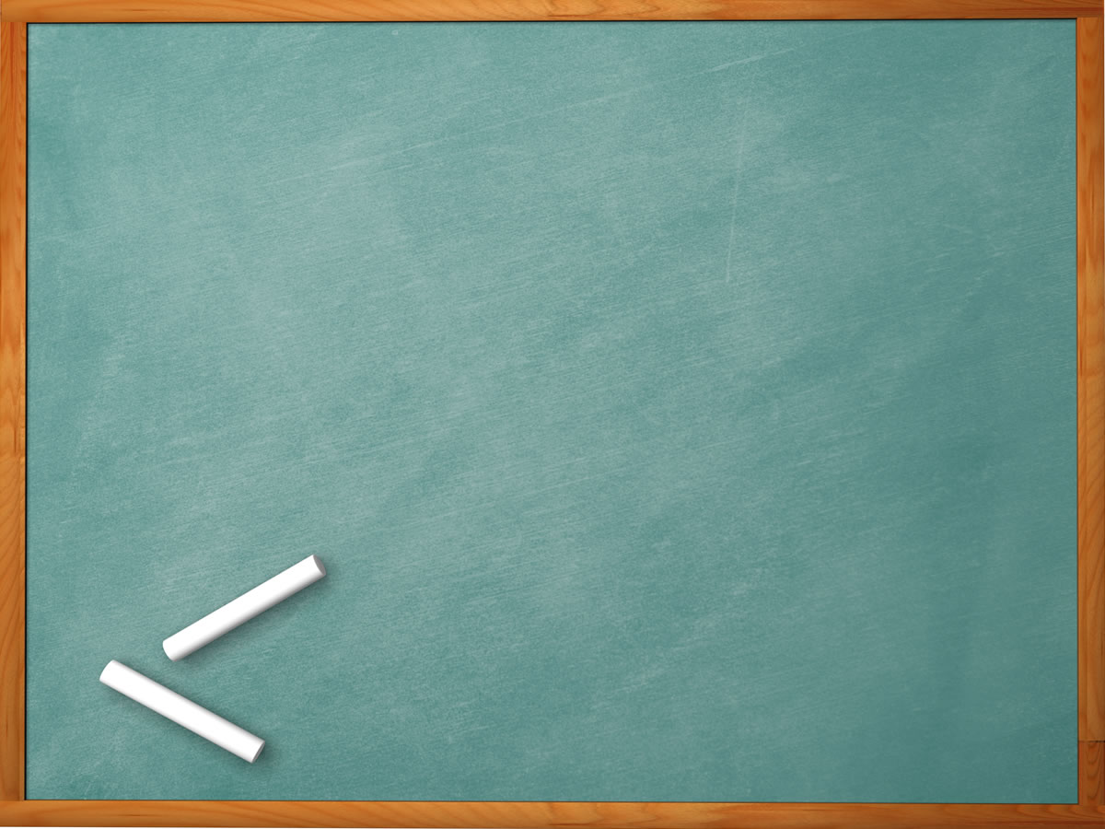
Welcome to all
for the MHRM Online lecture
By
Mr. Dhiraj Ovhal
HOD of Commerce

Slide 2
Chapter -3
Marketing Decision –II
(Place and Promotion)

Slide 3
Meaning and Definition of Marketing Mix?
Meaning:- Marketing mix means of Combination of
“4 Ps” i.e. Product, Price, Place & Promotion
Definition:- In 1960, E. Jerome McCarthy defines
“The basis of Marketing operations is the co-ordination of four key variables, namely : Product, Price, Place and Promotion”.
( Way to remember :- -co-ordination of four key variables, )

Slide 4
Q.4. Supply Chain Management & Components
It refers to the management of flow of goods and services from the producer to consumers

Slide 5
Components:-
Planning
2. Sourcing (Procurements)
3. Processing and scheduling delivery
4. Delivery (Logistic)
5. Management Returns (after sales services)

Slide 6
Q.5. Logistic (delivery) --------------- AMAZON. FILPKART
It is one of the essential parts of supply chain management.
It starts with to get order from customers, delivery the same products, with the help of Transport, Warehousing, Packaging, storing, insurance, after sales services, etc.

Slide 7
Q.5. Logistic (delivery) --------------- AMAZON. FILPKART
Philip Kotler defines logistics as "planning, implementing, and controlling the physical flows of materials and finished goods from the place of origin to the point of use to meet the customer needs at a profit."

Slide 8
1.Elements of Logistic
2. Facility location and network design
3. Customer service standard (domino pizza-30 minutes)
4. Customer order processing
5. Warehousing and storing materials
6. Transporting
7. Material handling 8. Inventory management

Slide 9
1.Elements of Logistic
It is one of the essential parts of supply chain management.
It starts with to get order from customers, delivery the same products, with the help of Transport, Warehousing, Packaging, storing, insurance, after sales services, etc.

Slide 10
2. Facility location and network design:-
The logistics department must design the location of facilities from where the lo operations would be carried out and their interconnection
The logistics department should decide about the locations and number of logistics facilities like material handling facilities manufacturing plants, warehouses, wholesale and retail out
These aspects of logistics would affect other aspects like level of inventory, transportation, packaging and delivery.

Slide 11
3. Customer service standard (domino pizza-30 minutes):-
It refers to the quality of service, which a firm provides to its customers. The company's management sets quantitative guidelines for customer service. For instance, Domino's Pizza has set standard for delivery within 30 minutes of placing the order.
At times, the customer sets the service standard and accordingly selects suppliers that meet or exceed those standards. For instance, a hospital was considering constructing a warehouse to stock the medical supplies which its staff uses each day. However, the construction cost was huge and it also required space. Therefore, the hospital management contracted a supplier that could deliva, medical supplies on a daily basis. To ensure availability or medicines and surgical supplies, the supplier makes day deliveries on a just-in-time basis to the hospital.

Slide 12
4. Customer order processing:-
Order processing is concerned the actual preparation of an order for shipment. It involves of orders and processing of order so that the ordered pro reach to the customer at the right time and at the right plan . It involves receipt
The order processing section must verify the following:
Location of the delivery.
Specifications of the order.
Delivery schedule.
Payment terms and conditions.

Slide 13
5. Warehousing and storing materials:-
The warehouses can be grouped under two broad categories:
A storage warehouse keeps products for relatively long periods of time and is used most often for products that are seasonal in supply or demand.
A distribution warehouse is used to gather and redistribute products. Distribution warehouses keep products for a time as short as possible. They are mainly used by manufacturers that have several small customers at different locations.

Slide 14
6. Transporting :-
It facilitates the movement of from the supplier to the buyer. The form of transportation used to ship products depends primarily on the kind of product, the distance, etc.
Transportation Modes: The movement of goods can take place through various modes of transport such as air, road, rail, water, and pipeline (for gas). The choice of mode of transportation depends on certain factors such as nature of goods, location of the customer, cost of transportation, etc.

Slide 15
7. Material handling:-
Material handling refers to the activity of moving items within plants, warehouses, transportation terminals and retail stores. Equipment used to handle goods includes forklift trucks, conveyor belts, and trucks.
Unitization and containerization have improved materials handling in many ways:
Unitization - combining as many packages as possible in one load that can be handled by a forklift truck. It is sometimes done with steel bands or shrink packaging. Containerization, putting packages, usually made up several unitized loads into a form that is relatively easy transfer

Slide 16
8. Inventory management:-Inventory management is concerned with maintaining the right level of inventory to meet customer requirements at the lowest cost. Inventory management tries to achieve a balance between costs of maintaining inventories and customer satisfaction. To reduce inventory costs, many firms use computerized inventory control management systems
The company should maintain right level of inventory. Over inventory and under-inventory is to be avoided.

Slide 17
Thank You

Slide 18
Attendance Link
https://forms.gle/Xqvykv5vfEi1zpyF7
(Mention date at last point)

